Slide 1
Bental | Engineering Build Plan
1. Build Schedule
YYYY | 2022 |  |  |  |  |  |  |  |  |  |  |  | 2023 |  |  |  |  |  |  |  |  |  |  |  | 2024
MM | 1 | 2 | 3 | 4 | 5 | 6 | 7 | 8 | 9 | 10 | 11 | 12 | 1 | 2 | 3 | 4 | 5 | 6 | 7 | 8 | 9 | 10 | 11 | 12 | 1 | 2 | 3
Paju
C6.0 Build (3/29~7/21)
C2.0 Build ( 10/15~ )
C6.1 Build (7/20~11/08)
C4.0 Build (3/15~ )
C3.0 Build ( 8/01~ )
C5.0 Build ( 11/08~ )
MP
C5.0 Build ( 01/20~ ), New ASIC(Gila) (1/26~)
2. C6.1 Build plan : Ongoing
As of this week
 | JUL |  |  | AUG |  |  |  | SEP |  |  |  | OCT |  |  |  | NOV
FOL
EOL
Tx, Compl OQC Tester
SMT : 7/26~8/19(Mask Down selection DOE
Build End
: 11/13
Build Strat
: 7/13 →7/18
Substrate ETA updated
Dot/Flood AlN attach : 8/04~8/24
Dot/Flood VCSEL attach : 8/05~8/29
Wire bonding : 8/11~12 LBU, 8/18~8/30 Main
FOL Test : 9/06~9/30
Housing Plasma : 7/18~7/20
OSA with STM : 7/22~~8/19
OSA With TSMC 8/20~8/28
Active Align with STM main OSA: 8/10~10/13
AA with TSMC OSA and DOE: 10/14 ~ 10/28
EOL process
LBU : 8/18~8/31
STM Main config EOL Process
9/16~10/21
TSMC Main config EOL Process : 10/24~11/10
EOL
CompliancOQC
LBU 8/31~9/05
SW validation
STM Main EOL/Comp/OQC
TSMV Main & DOE EOL/Comp/OQC
11/05~11/13

Slide 2
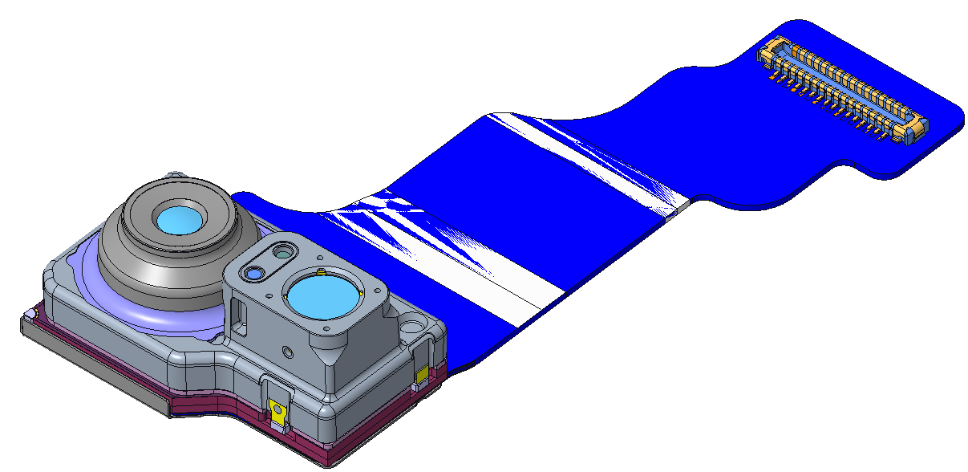
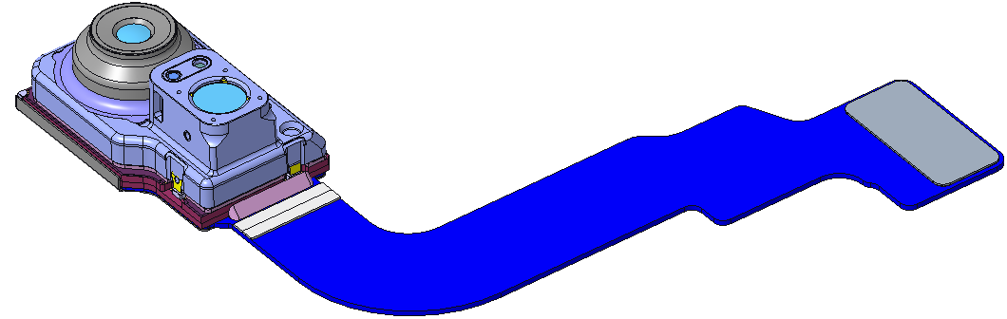
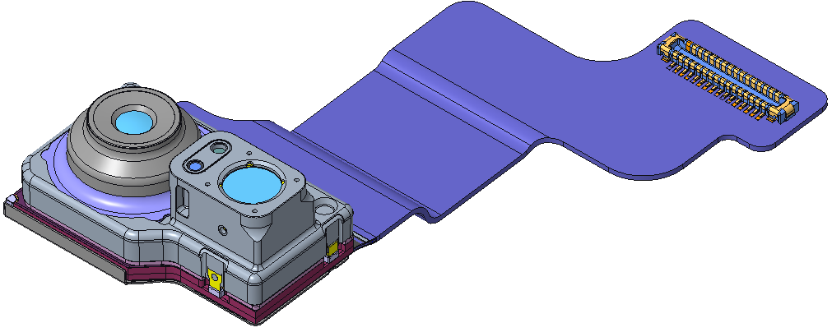
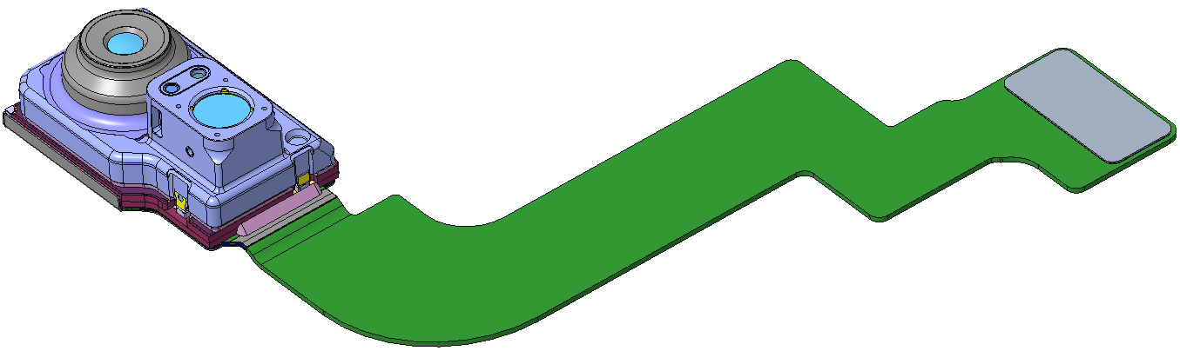
Sphinx | Build status
Build Status
- Sphinx-E/J C4.0 build is ongoing.
→ LBU lot is in progress, and the first config is in FOL process
- Sphinx-P/F C4.0 will start in Nov.
→ OK2build will be submitted in 10/25
10/17
Program | 22Y |  |  |  |  |  |  |  | 23Y
 | May | Jun | Jul | Aug | Sep | Oct | Nov | Dec | Jan | Feb | Mar | Apr | May | Jun | Jul | Aug | Sep
Sphinx-E/J
Sphinx- P/F
C5.0
7/1
C4.0
9/28
C3.0
1/13
C3.1
Sphinx-E
3/10
C2.0
Sphinx- J
Sphinx-E
4/21
Sphinx-J
AVB
OVB
PRB
PVT
11/7
2/13
4/10
6/6
C5.0
7/29
C4.0
11/2
C3.0
Sphinx-F
2/17
C3.1
4/7
C2.0
Sphinx- F
Sphinx-P
5/19
Sphinx-P
AVB
OVB
PRB
PVT
12/12
3/20
5/18
6/19

Slide 3
05
Master Plan
 | Item | ACE DRI | Due
Critical Decision point | - C3.0 design needs to be locked down after checking some of critical C5 REL items’ result. - Brahe(prism ass’y level) IPQC machine should be stable. Sometimes log can be disappeared. Barcode reading jig is not stable. YTC’s help is needed. - EE testers for pismo ass’y need to be optimized. E8M(for DCR), E3V(for TDR) UPH should be increased, and Pistoia(for LDR power) should be ready on time. - Jahwa config is not assigned during C4 build matrix. It means there is no chance to decide Jahwa VCM as MP POR. - C4 build plan is very tight since prism design locked down lately. | Cathleen, Eric, Ali YTC Jason, Alex, Pino Cathleen, Eric Cathleen, Eric | ‘23.11.30 ’22.11.19(C4 IPQC) ‘23.1.6(C3.0) ‘22.11.30(mid of C4.0) -
VR-P |  |  |  |  | Oct |  |  |  |  | Nov |  |  |  |  | Dec |  |  |  | Jan |  |  |  |  | Feb |  |  |  | Mar |  |  |  | Apr |  |  |  |  | May |  |  |  | Jun |  |  |  | Jul
Build | Eng | Eng | C5.0 | 7/29 ~
 |  |  | C4.0 | 10/14~
 |  |  | C3.0 | 1/7~
 |  |  | C3.1 | 2/25~
 |  |  | C2.0 | 4/14~
 | Ops | Ops | AV1 | 10/24~
 |  |  | AV2 | 11/11~
 |  |  | OVB | 1/10~
 |  |  | PRB | 4/1~
Reliability |  |  | C5.0_Last | Drop test
 |  |  |  | HTHH (250hrs)
 |  |  | C4.0 | Drop test
 |  |  |  | HTHH (250hrs)
 |  |  | C3.0 | Drop test
 |  |  |  | HTHH (250hrs)
Factory Readiness |  |  |  | Campus 4 (FOL) |  |  |  |  |  |  |  |  |  |  |  |  |  |  |  | C3.0
 |  |  |  | Campus 4 (EOL) |  |  |  |  |  |  |  |  |  |  |  |  |  |  |  | C3.0
 |  |  |  | Campus3 (TEST)

Slide 4
WV | Master Plan
 | Item | ACE DRI | Due
Critical Decision point | None
WV |  |  |  | Oct |  |  |  |  | Nov |  |  |  |  | Dec |  |  |  | Jan |  |  |  |  | Feb |  |  |  | Mar |  |  |  | Apr |  |  |  |  | May |  |  |  | Jun |  |  |  | Jul
Build | Eng | C4.0 | 9/19~
 |  | C3.0 | 12/18~
 |  | C3.1 | 2/12~
 |  | C2.0 | 3/26~
 | Ops | AVB | No plan@GM
 |  | OVB | No plan@GM
 |  | Post PRB | 3/4~
 |  | PPVT | TBD
Reliability |  | C4.0 | Drop test
 |  |  | HTHH (250hrs)
 |  | C3.0 | Drop test
 |  |  | HTHH (250hrs)
Factory Readiness |  |  | Campus 4 (FOL) |  |  |  |  |  |  |  |  |  |  |  | C3.0
 |  |  | Campus 4 (EOL) |  |  |  |  |  |  |  |  |  |  |  | C3.0
 |  |  | Campus3 (TEST)
POR Blockers |  |  | Process
 |  |  | Material
Notes:
Main : 1인치, Ball type Sensor shift 적용가능성 (FPDC 최소화)
-Tele
1) 고배율 전개 가능성 & 시점 2) 지금 인물모드를 2,3배에서 잘쓰고 있는데 나중에 5배를 하게 되면 인물모드는 어떻게 하는지?
3) 텔레 카메라의 성능 강화 방향은 화질(센서 증가….) or 사용 배율 증가 어느 쪽이 맞다고 생각하는지?
S-wide
; 고화소 센서 적용 가능성 & 시점 1) Main sensor 화소가 48mp로 올라가는데 그에 맞춰 sub CM 화소도 같이 올라가는지 가능성 2) Sensor shift 를 wide 적용 가능성 /목적

Slide 5
MW LGIT | Master Plan
 | Item | ACE DRI | Due
Critical Decision point | OIS design: corner cut design Sensor quality and performance improvement VCM quality and performance improvement IQC tester: OIS/AF tester, MTF inf tester not yet available | Jordan Nandita YK/Erwin | C3.0
MW |  |  |  | Jun |  |  |  |  | Jul |  |  |  |  | Aug |  |  |  | Sep |  |  |  |  | Oct |  |  |  | Nov |  |  |  | Dec |  |  |  |  | Jan |  |  |  | Feb |  |  |  | Mar |  |  |  | Apr |  |  |  | May
Build | Eng | C5.0 | 6/18~
 |  | C4.0 | 9/25~
 |  | C3.0 | 1/5~
 |  | C3.1 | 3/20~
 |  | C2.0 | 4/20~
 |  | OVB | 1/22~
 |  | PRB | TBD
 |  | PPVT | TBD
Reliability |  | C4.0 | Drop test
 |  |  | HTHH (250hrs)
 |  | C3.0 | Drop test
 |  |  | HTHH (250hrs)
Factory Readiness |  |  | Campus 1 (FOL)
 |  |  | Campus 1 (EOL)
 |  |  | Campus3 (Test)
POR Blockers |  |  | Process
 |  |  | Material
Notes:
Item
ACE DRI
Due
Critical
Decision point
None.

Slide 6
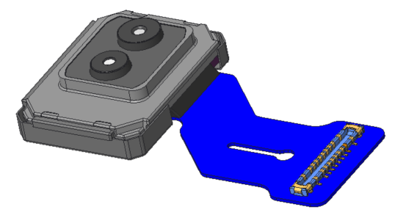
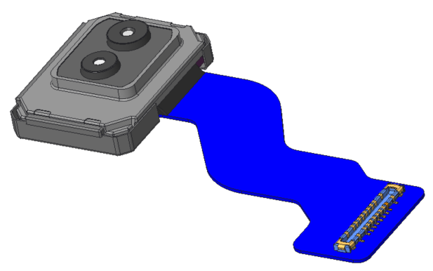
Peridot | Build status and plans
Peridot-J C4.0 build on-going
→ CALS, Compliance and CALRS bring up on-going / C4000F config FATP shipment : 11/7
Peridot-P C4.0 will be started from 10/31.
→ OK2build will be submitted in 10/25.
Machine transfer
Paju → Gumi
10/28
Paju(C6/C5/C4)
Gumi(C3/C2/PVT)
Project | 22Y |  |  |  |  |  |  |  | 23Y
 | May | Jun | Jul | Aug | Sep | Oct | Nov | Dec | Jan | Feb | Mar | Apr | May | Jun | Jul | Aug | Sep
Peridot-J
Peridot- P
Peridot-L/R
C5.0 5/21 ~
C4.0 9/26 ~
12/16~
C3.0 1/4 ~
C3.1 3/1 ~
C2.0 4/12 ~
AVB 11/23 -
12/28~
OVB 2/6 ~
PRB 3/20 ~
PVT 6/B ~
C5.0 7/13 ~
C4.0 10/31 ~
1/15~
C3.0 2/8 ~
C3.1 3/29 ~
C2.0 5/12 ~
OVB 3/6 ~
PRB 4/5 ~
PVT 6/B ~
C5.0 6/M ~

Slide 7
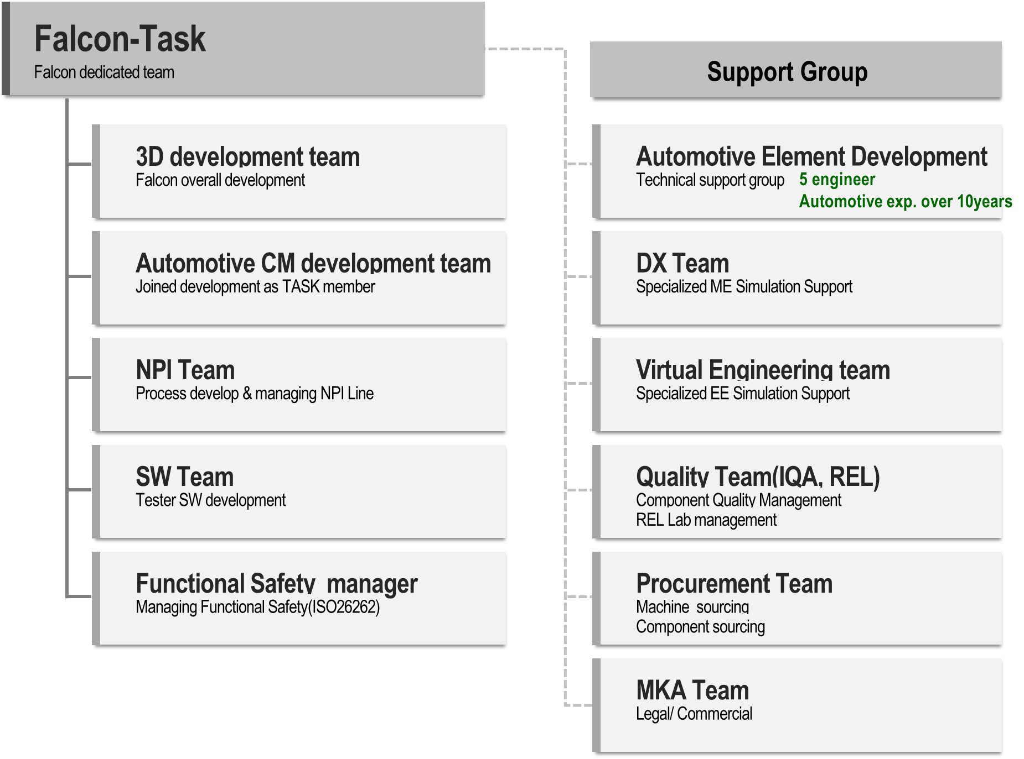
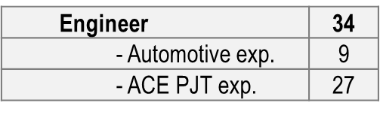
Falcon | Falcon Organization
LGIT organized dedicated Falcon-Task group including automotive experienced members.
[History]
[Falcon Organization]
Event
Remark
~’21.07
Falcon Members |  | Total
ACE | Automotive
8 | 5 | 13
Reviewed RFQ
~’21.12
Highlight from ACE
Request from ACE to increase members
who have automotive experience.
~’22.01
Members |  | Total
ACE | Automotive
19 | 7 + (5) | 26
1st strengthened roster
Organize technical support group: 5 eng’rs
Current
Members |  | Total
ACE | Automotive
27 | 9 + (5) | 36
Continuously Strengthen roster
Organize technical support group: 5 eng’rs
Future
Reviewing Flexible M/M
Notes:
Next plan이 있다면 team roster를 flexible adjust하는데 도움이 될 것이다.

Slide 8
Falcon | C6.0 Build Status
Build Status
- Main build start: 11/07/2022
- Build sequence: Otter → Eagle → Falcon
→ New FPCB is used in main config.
→ Sony IMX728 ES3 sensor will be used from main config.
→ Cover case and window attach process will be skipped.
Project | Config | 22Y |  |  |  |  |  |  |  |  |  | 23Y
 |  | Mar | Apr | May | Jun | Jul | Aug | Sep | Oct | Nov | Dec | Jan
Otter | Mini/Set-up
 | Alpha
 | Small
 | Main
Eagle | Mini/Set-up
 | Alpha
 | Small
 | Main
Falcon | Mini/Set-up
 | Alpha
 | Small
 | Main
10/27
3/10
4/19
4/11
6/20
7/28
10/31
11/7
12/6
Input: 1.4K
5/2
6/21
5/4
7/9
7/28
10/12
11/24
12/22
Input: 0.6K
5/21
7/22
5/24
8/1
7/28
10/14
12/13
1/18
Input: 1.4K
Notes:
Total C6.0 build schedule

